Slide 1
Main Folder (Analytics Tool – Controls “F10”)
Data
InputLibrary
Required Folder Paths
Bold words must be named exactly how they appear here
Folder
File
Year (i.e. 2021)
GeneralSlides.pptx
Ad Hoc
Swings
DMA
Q1
Q2
Q3
Q4
Excel
PowerPoint

Slide 2
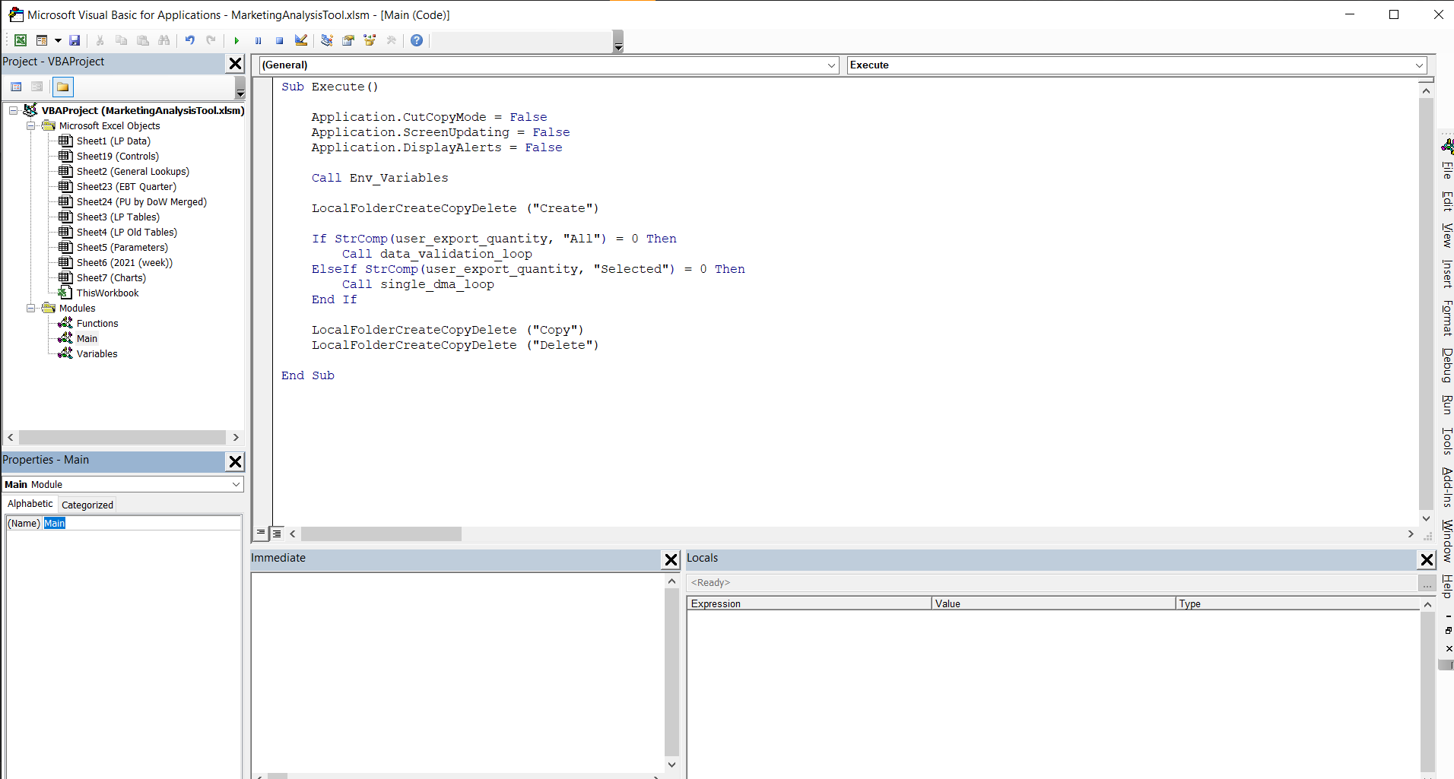
 | Worksheets
 | Modules
 | Function/Sub
 | Immediate Window
 | Start/Stop/Reset

Slide 3

Execute
Save Type
Fast
[Create]
Local_Folder_Create_Copy_Delete
Direct
[Copy]
[Delete]
Data_Validation_Loop
All
DMA Quantity
Selected
Operations Complete
Single_DMA_Loop
Function
Excel
Output
Excel_Open
Data Validation List
Direct
PowerPoint
Choice
DV List Selection
PowerPoint_Open
Charts_Loop
Fast
Save Type
[Input]
Function Input
Current_Chart_Loop
Output
Excel
Excel_Save
Loop
PowerPoint
PowerPoint_Save

